Slide 1
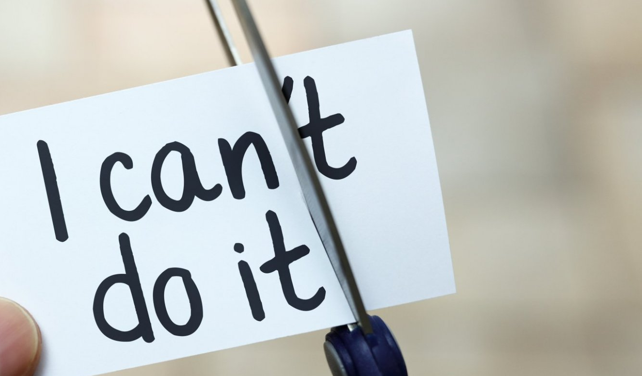
The power of inspiration
Taisiya Ben, Rozalia Baiguttieva, Roman Astrakhantsev

Slide 2
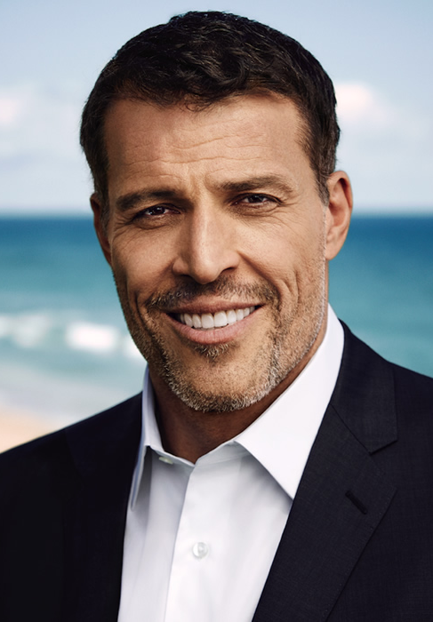
“Significance - the need to have meaning, special, pride, needed, wanted, sense of importance and worthy of love”

Slide 3
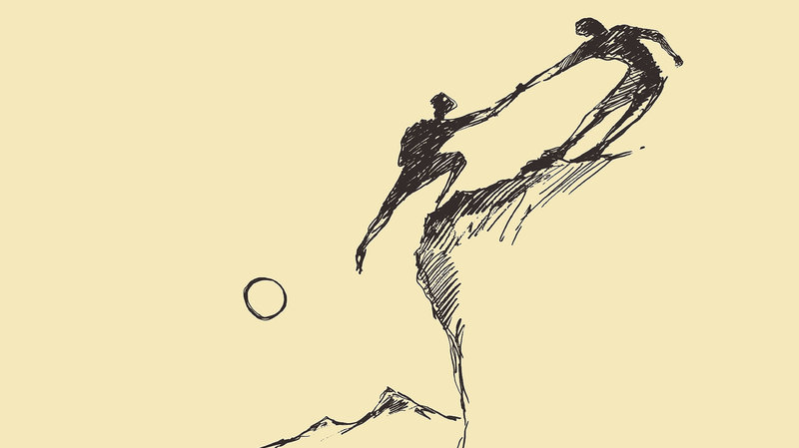
Altruism

Slide 4
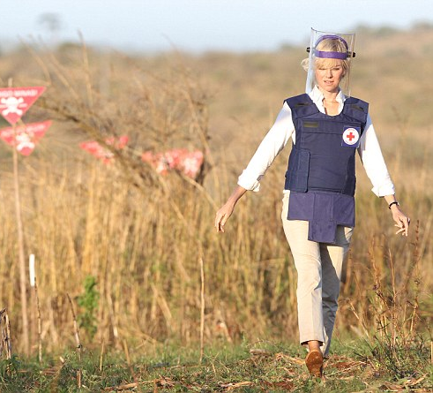
One of the strongest woman in the world

Slide 5
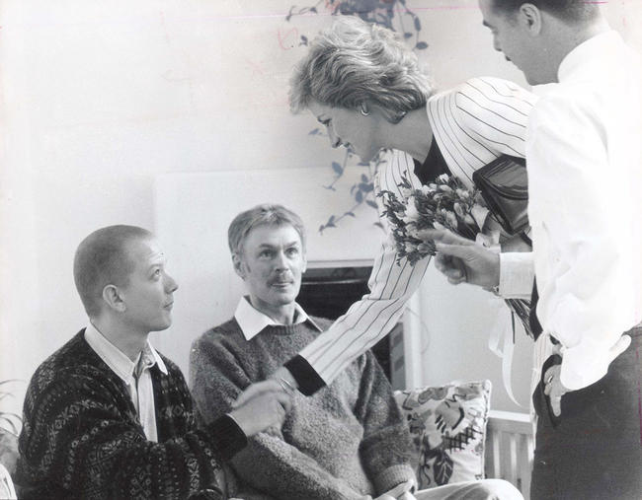

Slide 6
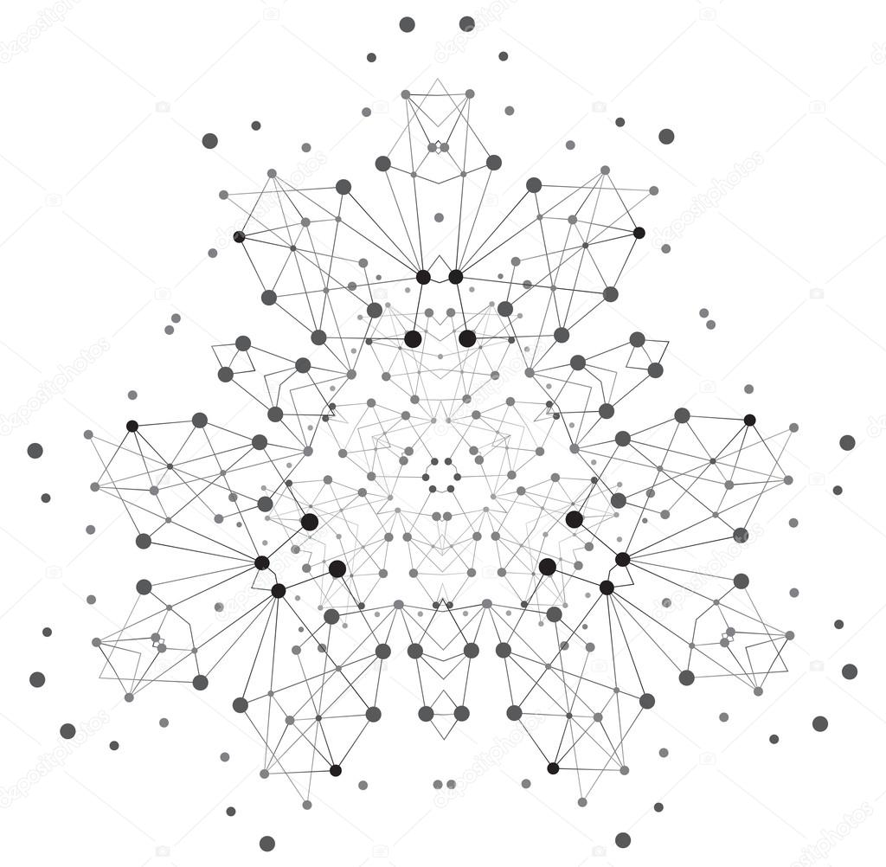
My way to contribute the society TODAY

Slide 7
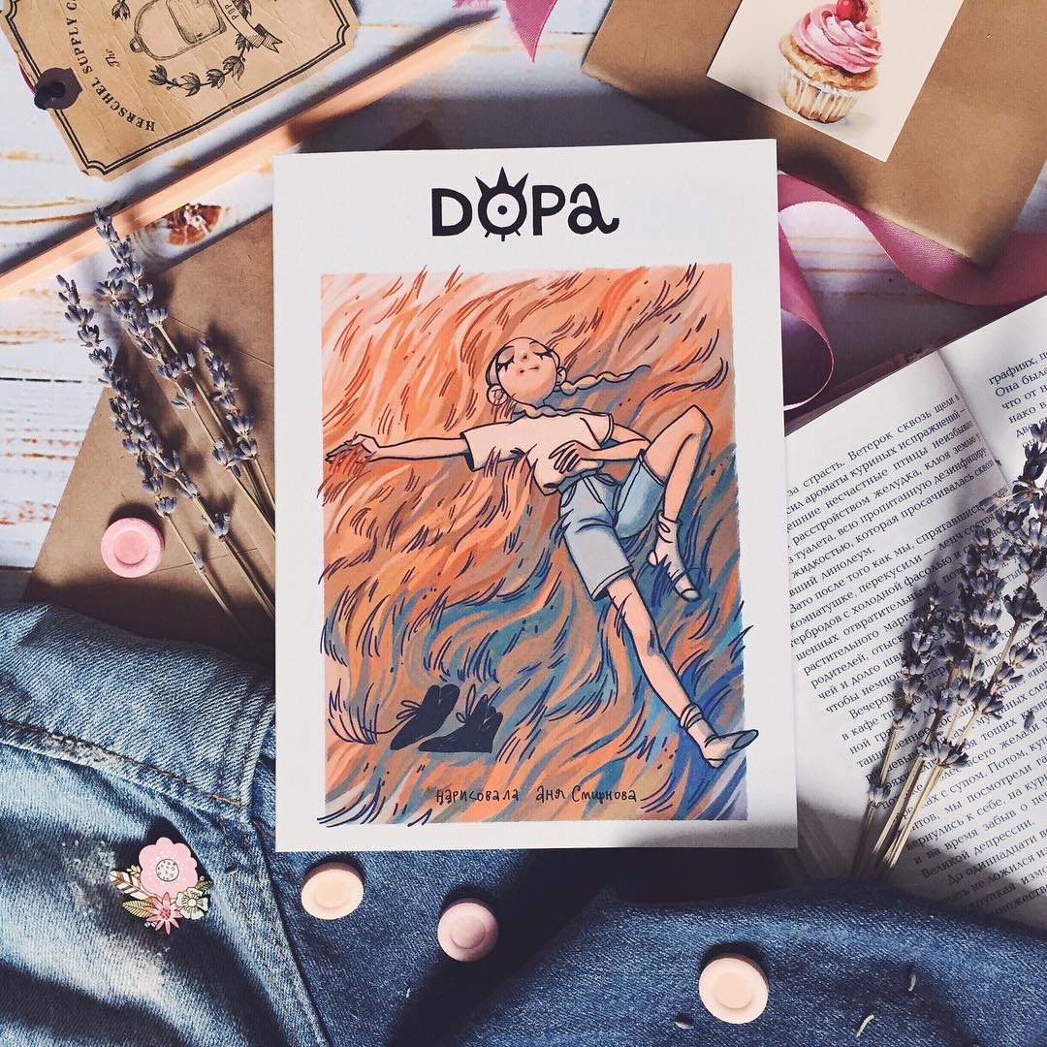
My way to contribute the society IN THE FUTURE

Slide 8

To be heard

Slide 9
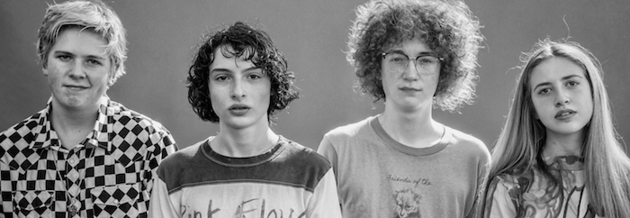
"You don't have to be an adult to be a musician," says Wolfhard

Slide 10
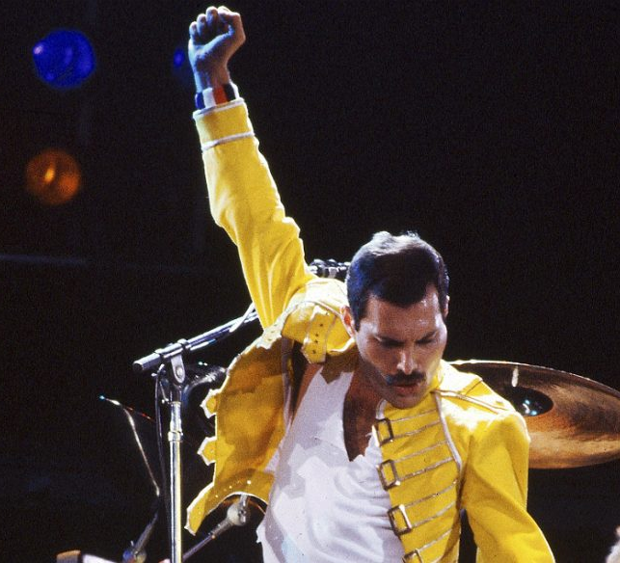
Hedonism

Slide 11
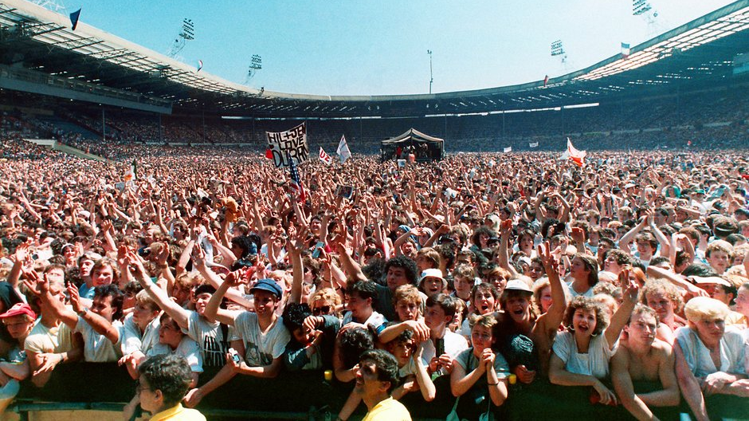
Charity

Slide 12
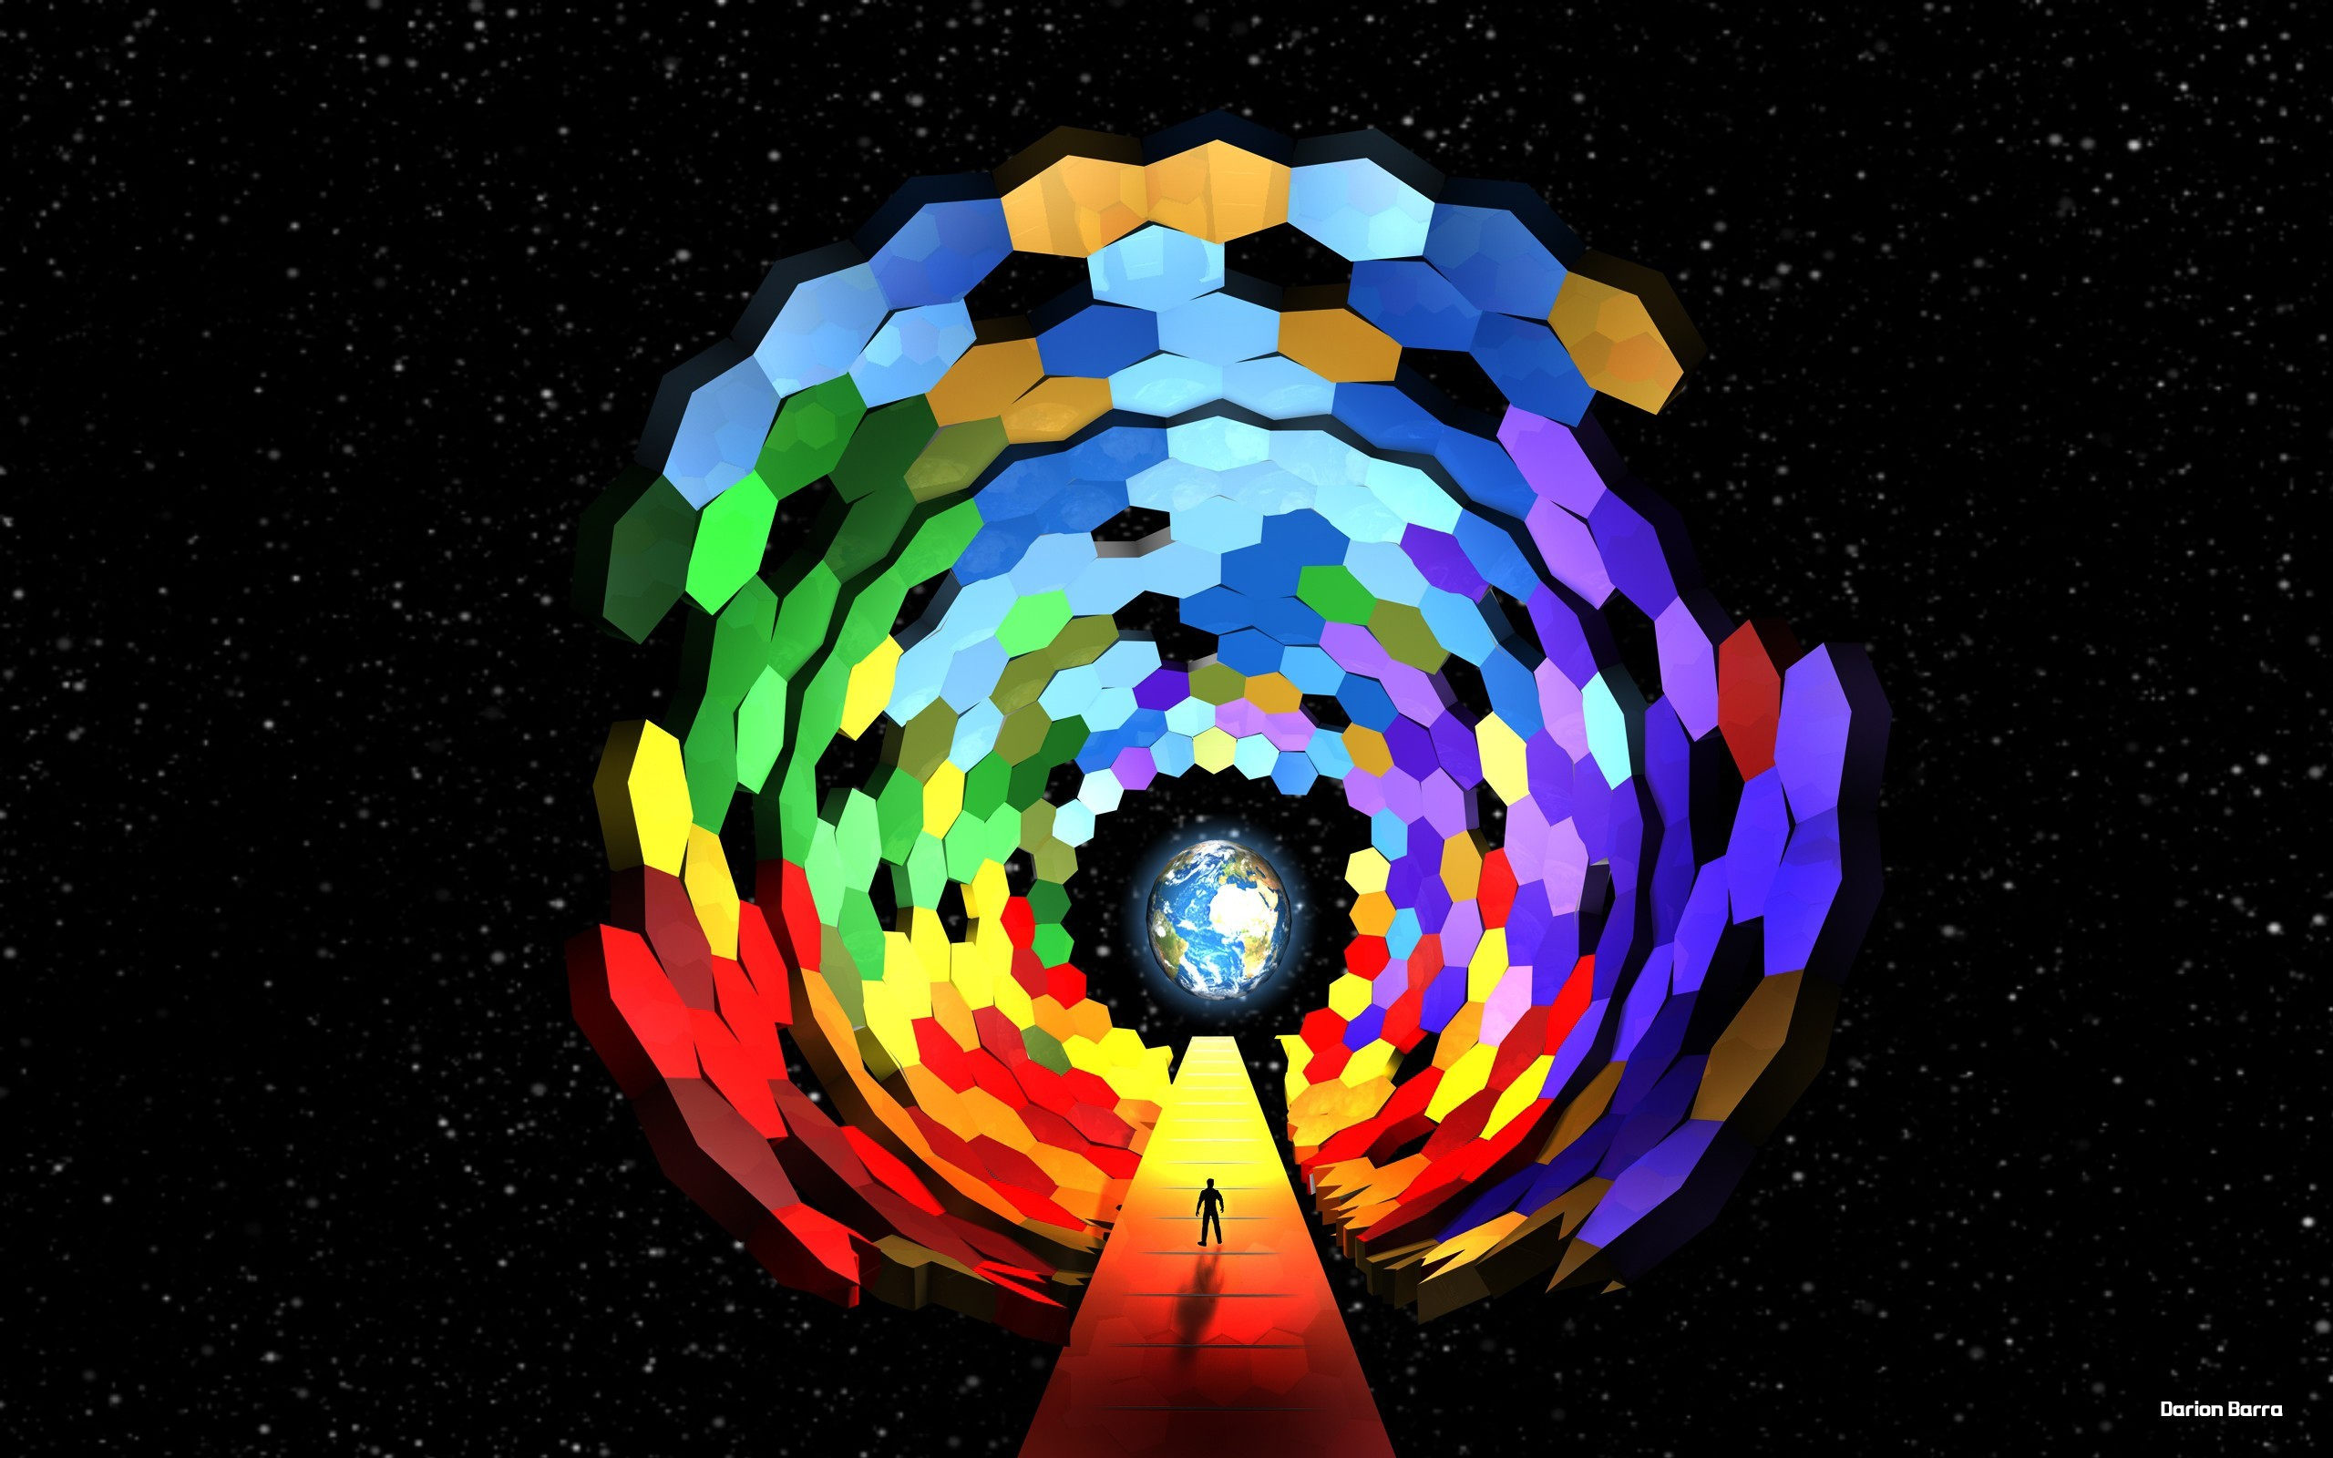
Resistance

Slide 13
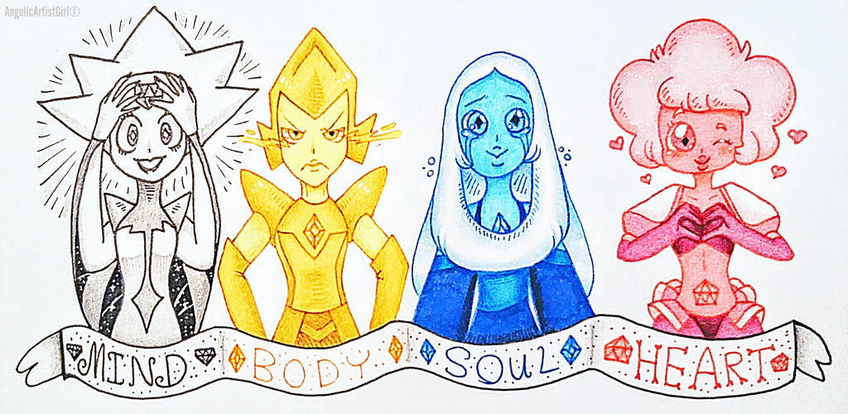

Slide 14
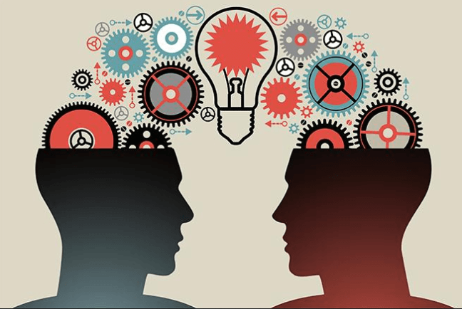
Sharing

Slide 15

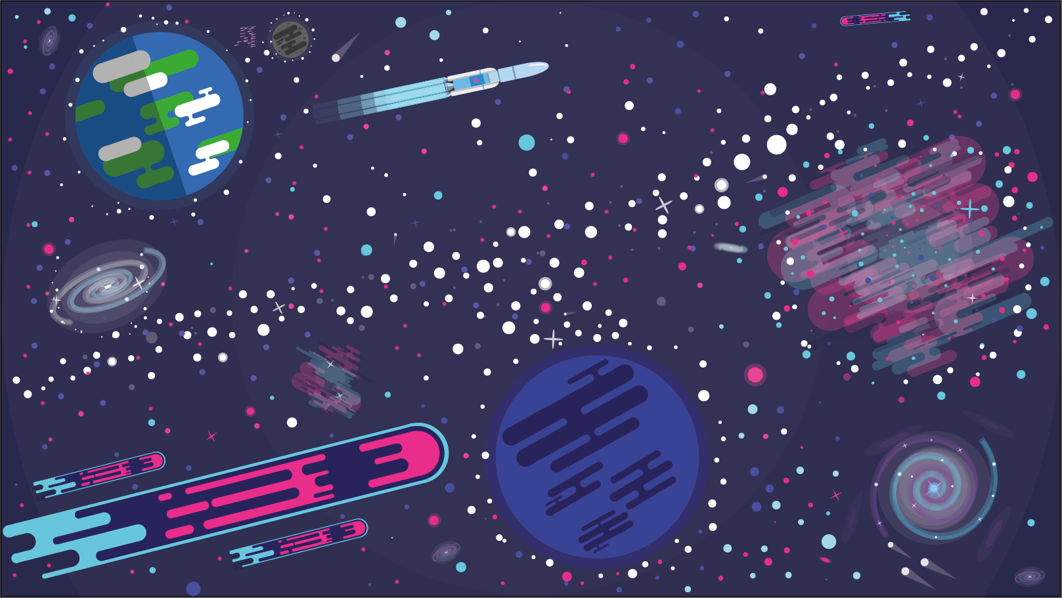

Complex is simple

Slide 16
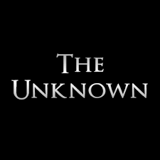

Everybody faces it
Everybody wants
to explore

Slide 17
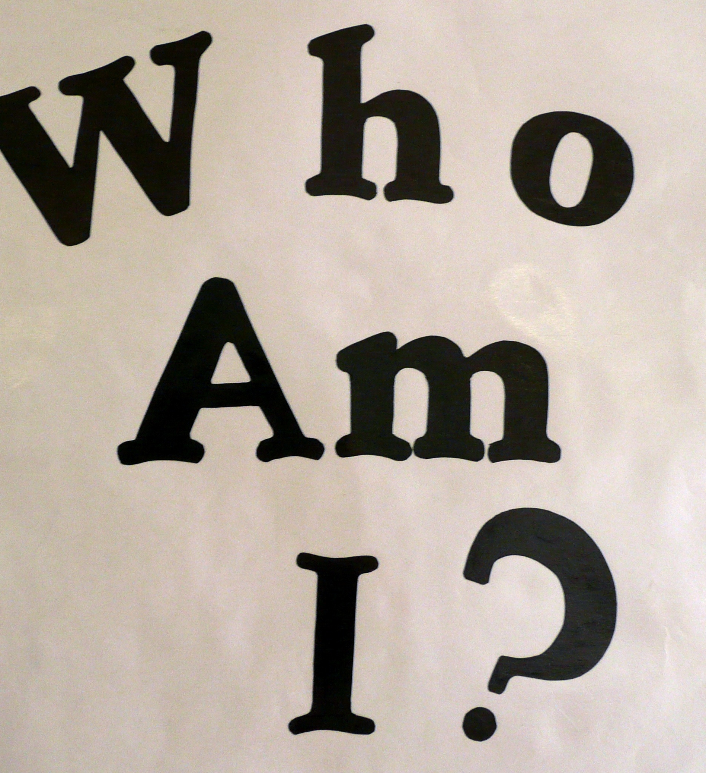
Exceling means searching

Slide 18
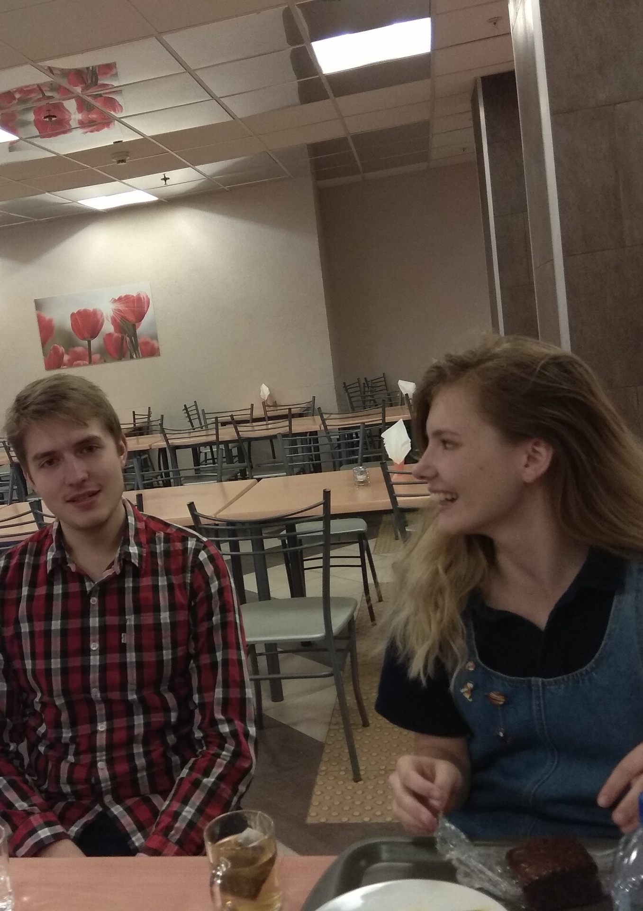
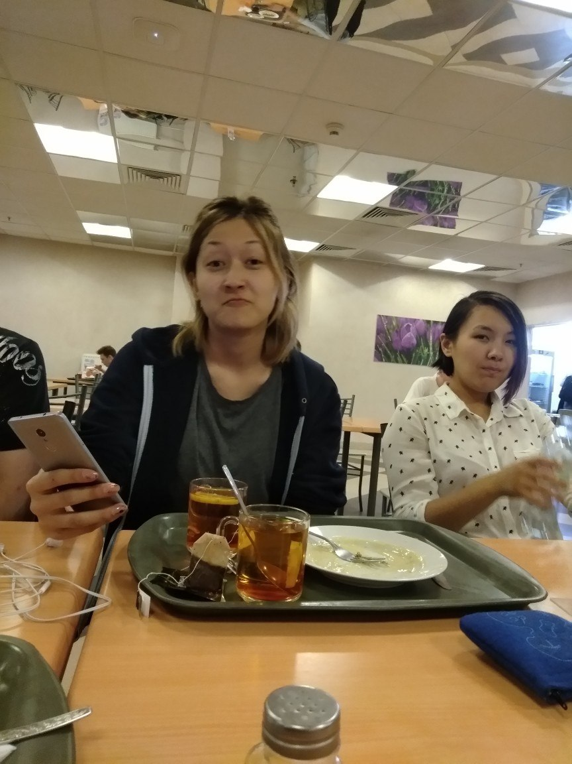
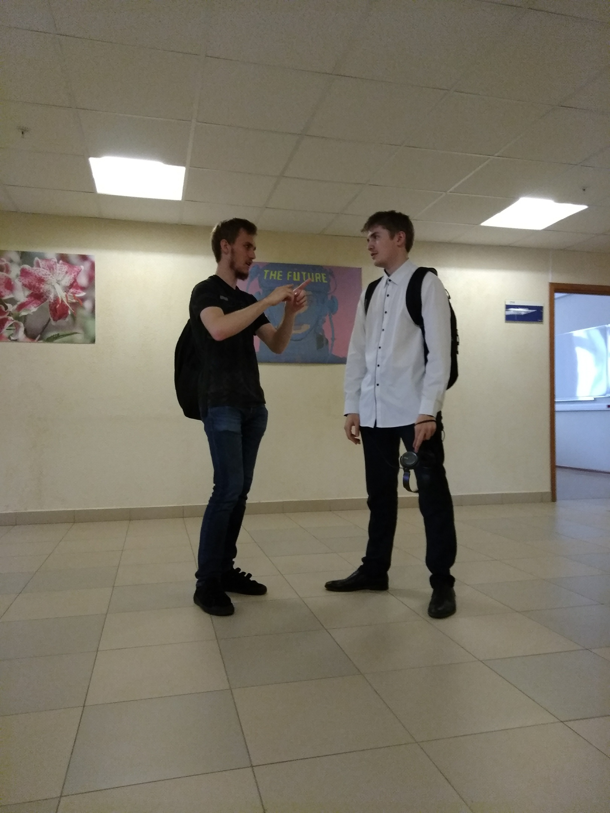
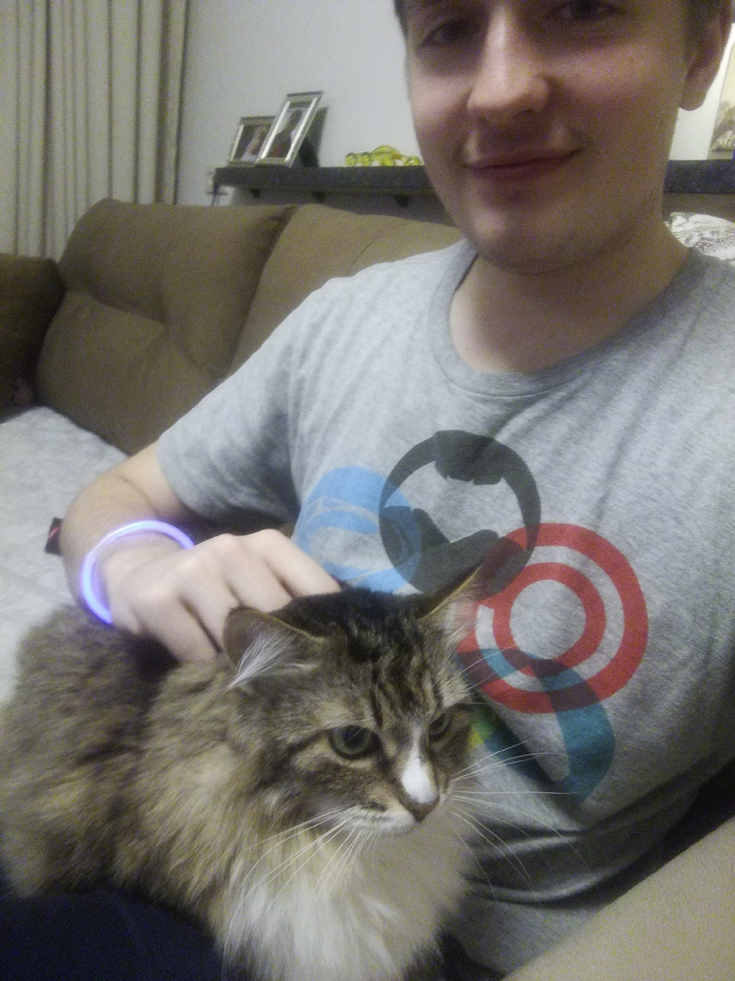
And, of course, friends…

Slide 19
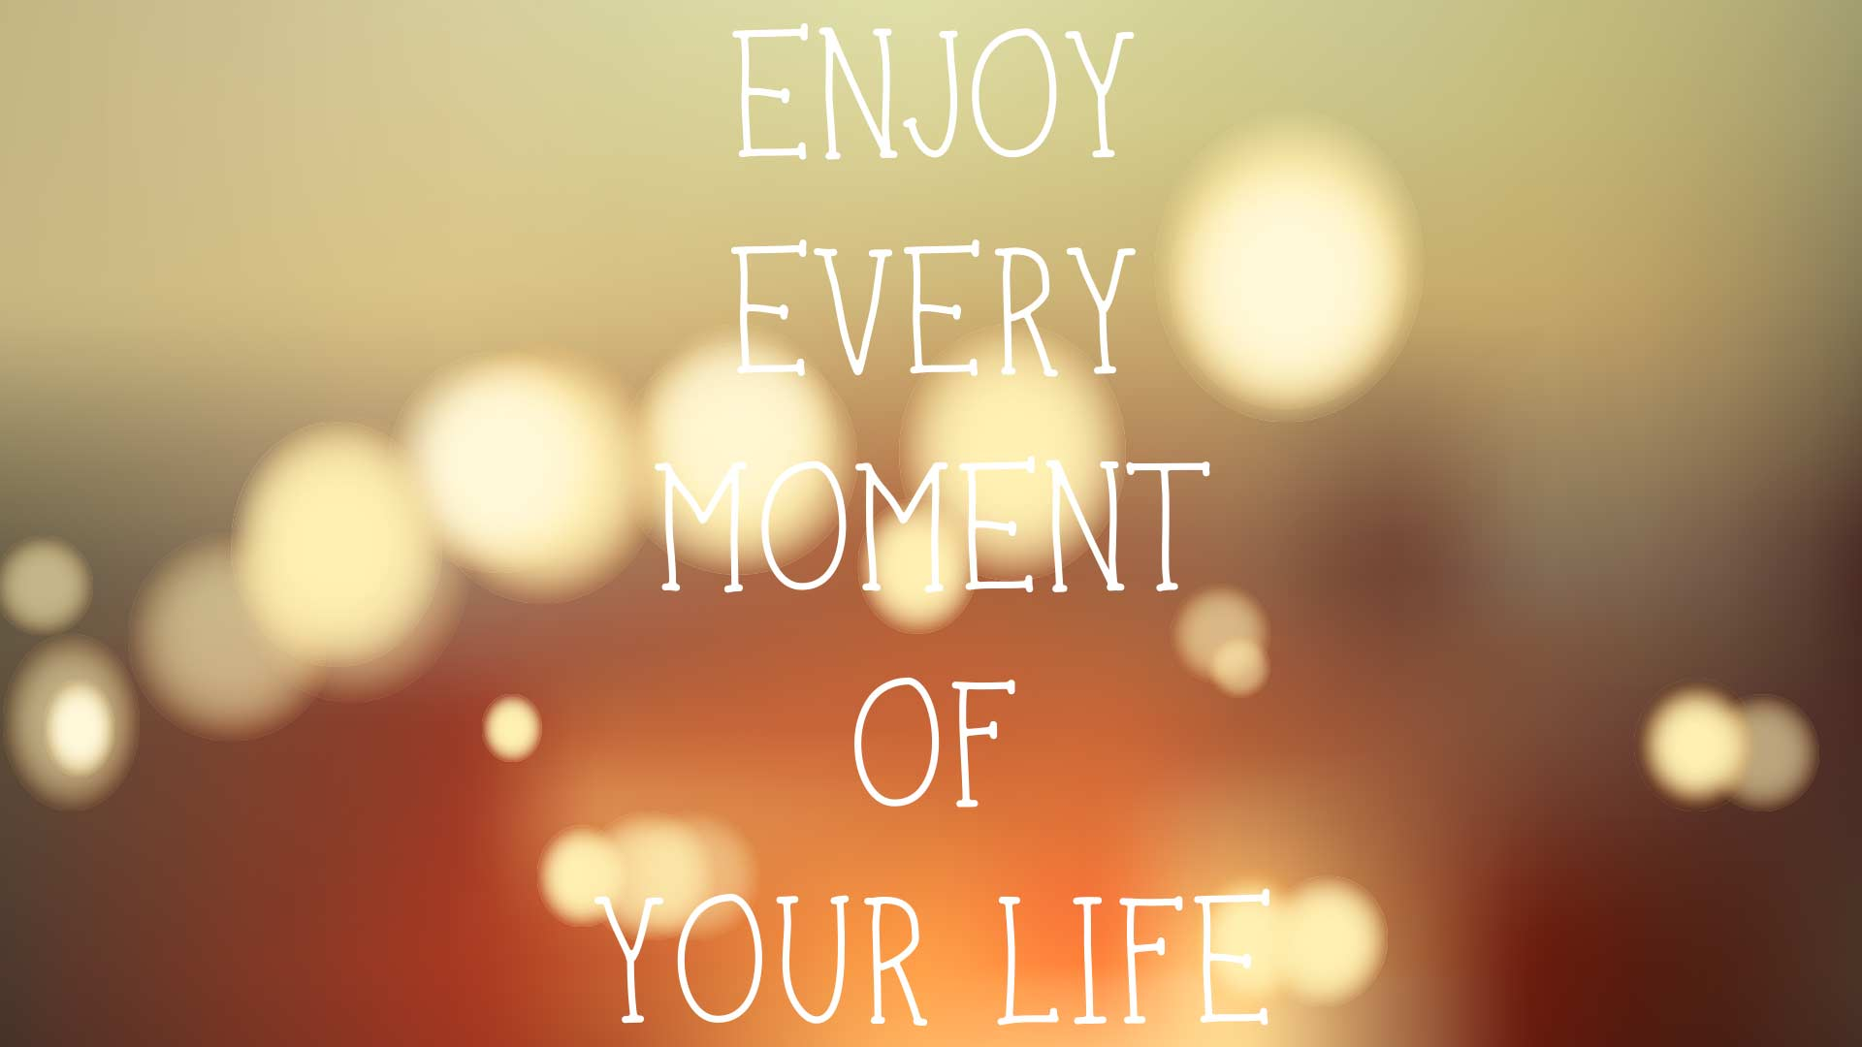

Slide 20


